Slide 1
Bulletproofs
Short Proofs for Confidential Transactions and More
Benedikt Bünz, Jonathan Bootle, Dan Boneh,
Andrew Poelstra, Pieter Wuille, Greg Maxwell

Slide 2
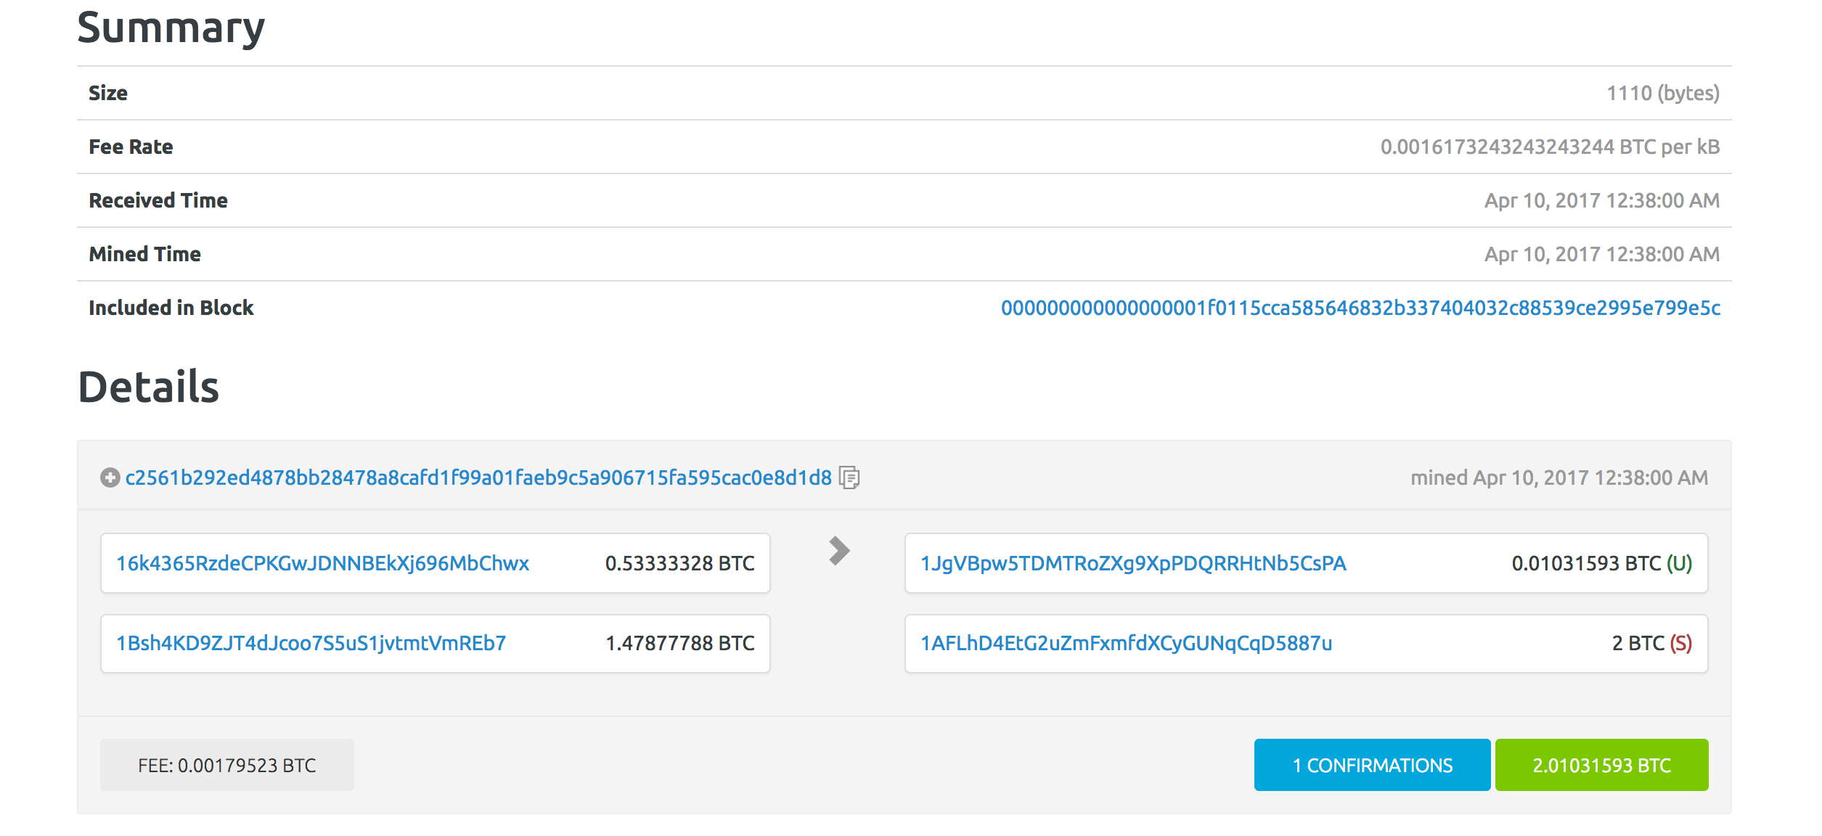
Bitcoin Transactions
2+0.0103≤ 0.5333+1.478

Slide 3
Validity of a Bitcoin transaction
Signature Is Correct
Inputs are unspent
∑ (input values) = ∑ (output values) + fee

Slide 4
Bitcoin is neither confidential or anonymous

Slide 5
Transaction amounts available in the clear
Everyone can see the payer, payee, and value
Business implications:
Company pays employees in Bitcoin ⇒ all salaries are public
Public supply chain prices:
How much does Ford pay its supplier for tires?

Slide 6
Confidential Transactions
Sum of inputs≥Sum of outputs?
Outputs positive?
g⁵³³h^{r1}
g¹⁰h^{r3}
g¹⁴⁷⁸h^{r2}
g²⁰⁰⁰h^{r4}
Pedersen commitment:
Commit(x;r)=g^{x}h^{r}
Notes:
Fee still public

Slide 7
Confidential Transactions [Maxwell 2016]
Confidential Transactions are structured like Bitcoin transactions
Transaction amounts are hidden
Compatible with Bitcoin
Transaction graph is still public
Public verifiability of transaction validity

Slide 8




Zero Knowledge Proof of Knowledge
No idea what $x$ is
But it’s positive and Peggy must know it
aka. Range Proof $x∈[{0,2}^{52}−1]$
“c$=g^{x}h^{r}$ is a commitment to a positive number $x$”
“Prove it”
Peggy
Challenge
Victor
Response

Slide 9
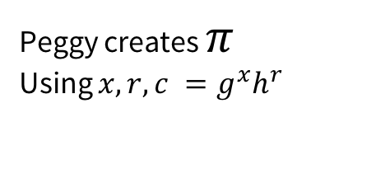
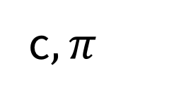
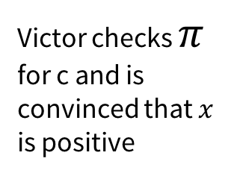
Non-Interactive Zero Knowledge Proof of Knowledge (NIZK)
CRS
c$,π$
Peggy creates $π$
Using $x,r,c =g^{x}h^{r}$
Victor checks $π$
for c and is convinced that $x$
is positive

Slide 10
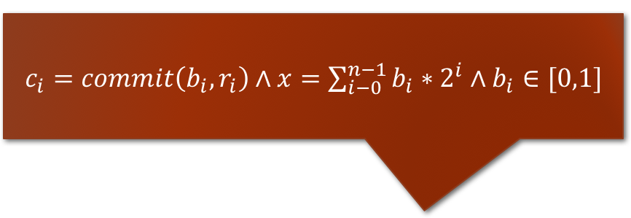
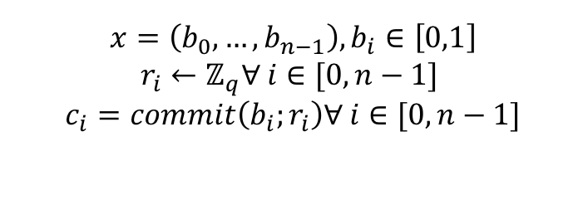

Concrete Range Proof using bit commitments
$c_{i}=commit\left(b_{i},r_{i}\right)∧x=\sum_{i−0}^{n−1}{b_{i}∗2^{i}}∧b_{i}∈[0,1]$
$c,c_{0},…,c_{n−1} π$
$$x=\left(b_{0},…,b_{n−1}\right), b_{i}∈\left[0,1\right]$$
$$r_{i}←ℤ_{q}∀ i∈[0,n−1]$$
$$c_{i}=commit\left(b_{i};r_{i}\right)∀ i∈[0,n−1]$$

Slide 11
Linear range proofs
Based on Sigma-Protocols with Fiat-Shamir heuristic
Recent optimizations by Poelstra et al. 17 2x improvement
4kb for 64bit range proof
Linear in the bit-length of range
No trusted setup

Slide 12

What about other range proofs?
Camenish et al. 08
Lipmaa 03
Sub-linear/constant sized range proofs available
Not practical
Require trusted setup (Groups of unknown order).
$$a^{2}+b^{2}+c^{2}+d^{2}=x$$

Slide 13
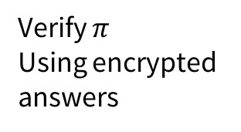

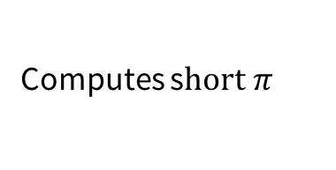
Preprocessing SNARKs (GGPR 13)
Encrypted and reusable queries (long)
Computes s$hort π$
Verify $π$
Using encrypted
answers
$$π$$

Slide 14

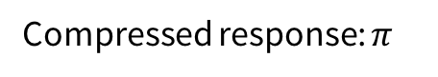
Preprocessing SNARKs with Trusted Setup (GGPR 13)
Encrypted
Queries
Short
Encrypted
Answers
Setup slow
Computes s$hort π$
Verify $π$
Using encrypted
answers
Compressed response: $π$
Proving slow
Verification fast

Slide 15

Preprocessing SNARK: Malicious Setup
Encrypted
Queries
Short
Encrypted
Answers
Can create cheating proofs
Computes s$hort π$
Verify $π$
Using encrypted
answers
Compressed response: $π$

Slide 16
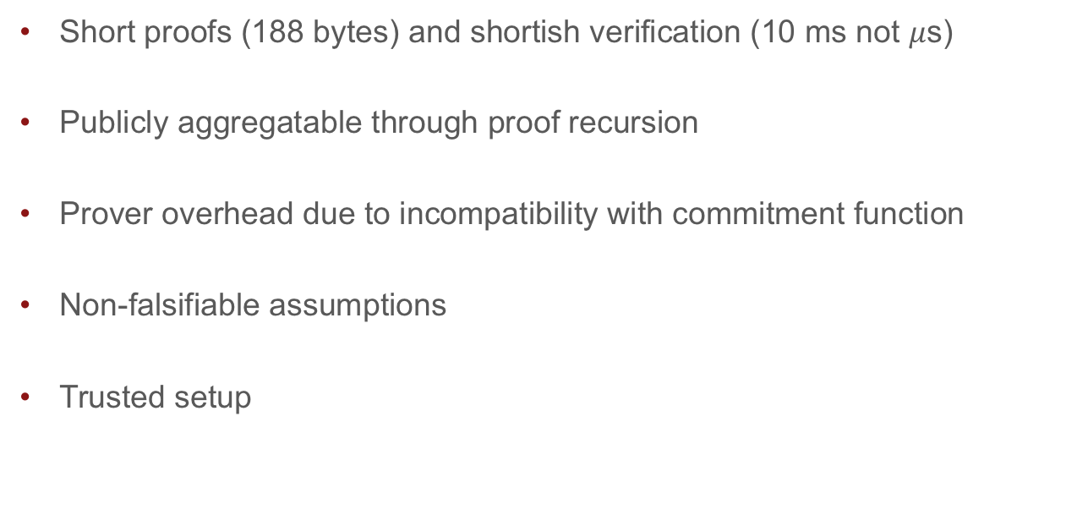
SNARKs for range proof
Short proofs (188 bytes) and shortish verification (10 ms not $μ$s)
Publicly aggregatable through proof recursion
Prover overhead due to incompatibility with commitment function
Non-falsifiable assumptions
Trusted setup

Slide 17
The problems with trusted setup in cryptocurrencies
If subverted prover can create fake proofs
Undetectable -> Undetectable inflation
Even the fear of undetectable inflation is dangerous
Can be alleviated through distributed setup
Expensive and difficult but done for ZCash
Low flexibility: New functionality-> New setup
HAWK: Every smart contract has a new setup

Slide 18
What about CS-Proofs/STARKs?
Micali 01, Ben-Sasson et al. 17
Based on PCP theorem and Fiat-Shamir heuristic
No trusted setup, log sized proofs and verifications
STARKs are somewhat practical CS-Proofs
>200kb proof size, prover overhead is massive (130 GB Ram for 2¹⁶ circuit)

Slide 19
Bootle et al. 16: Log-sized proofs for Arithmetic Circuits
Interactive multi-round protocol
Public coin (Verifier’s messages are random)
For arbitrary arithmetic circuits
Only discrete logarithm assumption
Proof size 6*log(n)+11 elements
Proving and Verifying is linear in the circuit
No proofs on committed values (important for range proofs)
Not much better for practical ranges

Slide 20
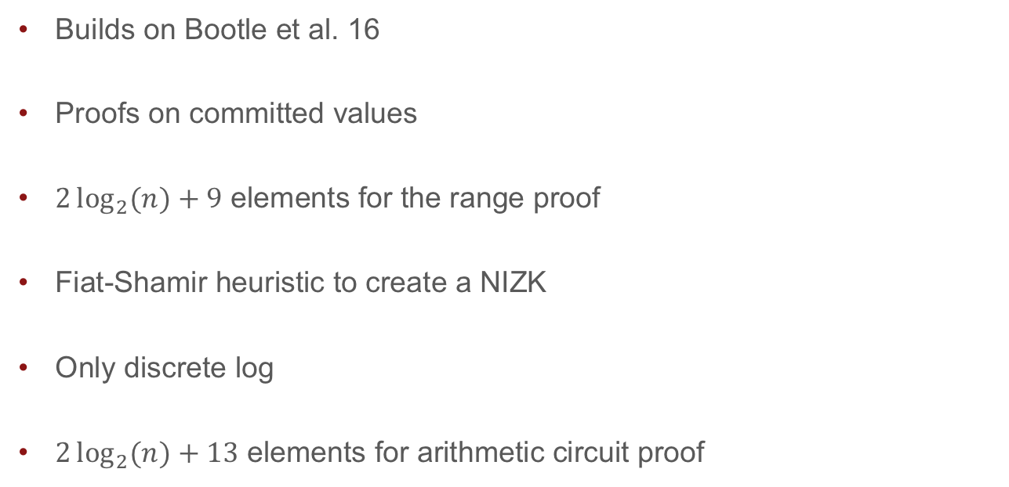
Bulletproofs
Builds on Bootle et al. 16
Proofs on committed values
$2\log_{2}{(n)}+9$ elements for the range proof
Fiat-Shamir heuristic to create a NIZK
Only discrete log
$2\log_{2}{(n)}+13$ elements for arithmetic circuit proof

Slide 21
Bulletproofs proof size (1 Range Proof)

Slide 22
Bulletproofs proof size (2 Proofs)

Slide 23
Bulletproofs proof size (10 Proofs)

Slide 24

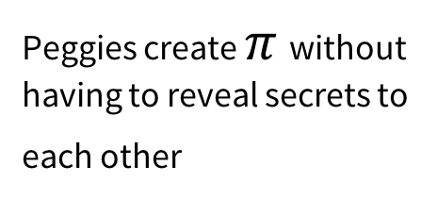


Non-Interactive Zero Knowledge Proof of Knowledge (NIZK)
$c_{1},c_{2},c_{3}$ are commitments to values in some range
$$π$$
Peggies create $π$ without having to reveal secrets to each other
Victor checks small $π$
Trivial solution:
Concatenate proofs

Slide 25
Bulletproofs MPC
Custom MPC to generate proofs
Works if circuits are disjoint, e.g. n range proofs for n provers
Simply aggregate proofs in each round and compute Fiat-Shamir challenge
Either log(n) rounds and log(n) communication
Or 3 rounds and linear O(n) communication

Slide 26
Bulletproofs for Confidential Transactions/Mimblewimble
670 bytes instead of 4 KB per range proof (64 bit range)
Aggregation: Two range proofs 736 bytes vs. 8 KB
16 range proofs 928 bytes vs. 61KB
Doubling precision adds 64 bytes
UTXO set/Mimblewimble size: 17 GB vs 160 GB
Built in: simple CoinJoin protocol for combining confidential transactions
No unconditional soundness/ quantum soundness

Slide 27
Proof size for circuits vs. SNARKs/STARKs
ZCash new circuit
ZCash old circuit

Slide 28
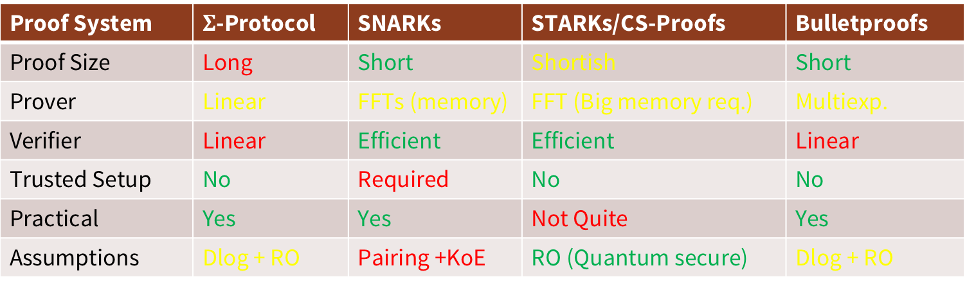
Comparing Proof Systems (Oversimplified)
Proof System | $Σ$-Protocol | SNARKs | STARKs/CS-Proofs | Bulletproofs
Proof Size | Long | Short | Shortish | Short
Prover | Linear | FFTs (memory) | FFT (Big memory req.) | Multiexp.
Verifier | Linear | Efficient | Efficient | Linear
Trusted Setup | No | Required | No | No
Practical | Yes | Yes | Not Quite | Yes
Assumptions | Dlog + RO | Pairing +KoE | RO (Quantum secure) | Dlog + RO

Slide 29
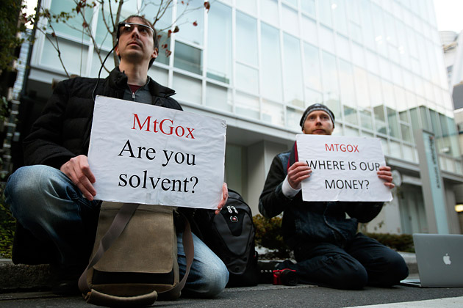
Bulletproofs for Solvency Proofs (Dagher et al. 15)
With Bulletproofs:
62 MB instead of 18GB

Slide 30
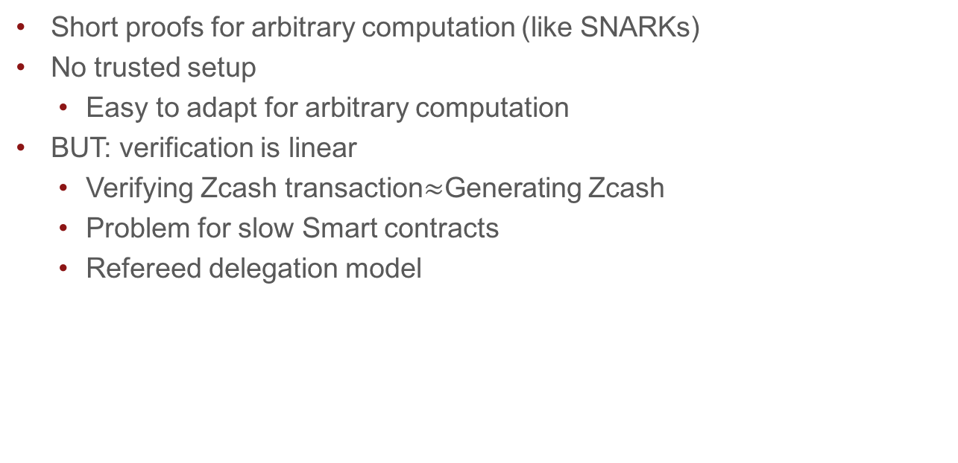
Bulletproofs for Smart Contracts
Short proofs for arbitrary computation (like SNARKs)
No trusted setup
Easy to adapt for arbitrary computation
BUT: verification is linear
Verifying Zcash transaction$≈$Generating Zcash
Problem for slow Smart contracts
Refereed delegation model

Slide 31
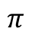
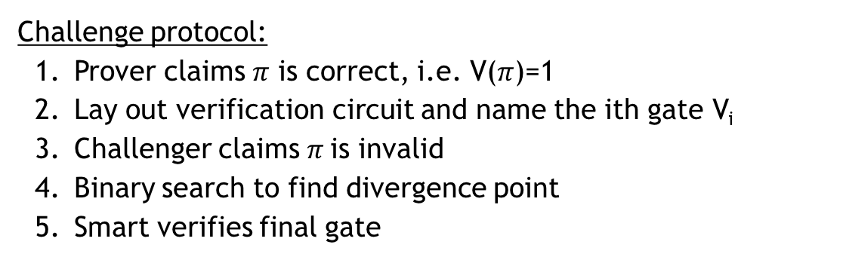

Refereed model
[Canetti,Riva, Rothblum, 2011]
$$π$$
V₁
V₂
V₃
...
V_{n/2}
...
V_{n}
0,1
Send to Smart Contract: $π$,V_{n/2}
Challenge protocol:
Prover claims $π$ is correct, i.e. V($π$)=1
Lay out verification circuit and name the ith gate V_{i}
Challenger claims $π$is invalid
Binary search to find divergence point
Smart verifies final gate
Cost:
lg t round
lg t communication, 1 gate computation

Slide 32
Bulletproofs for Verifiable Shuffles
n NIZKs that inputs and outputs are the same
Bulletproofs:
First log(n) verifiable shuffle without trusted setup

Slide 33
Bulletproofs Implementation
Integration into libsecp256k1 (Bitcoin library)
Amazing work by Andrew Poelstra, Pieter Wuille, Peter Dettman
Constant time prover
Fast verifier
Multiple other implementations started/planned

Slide 34
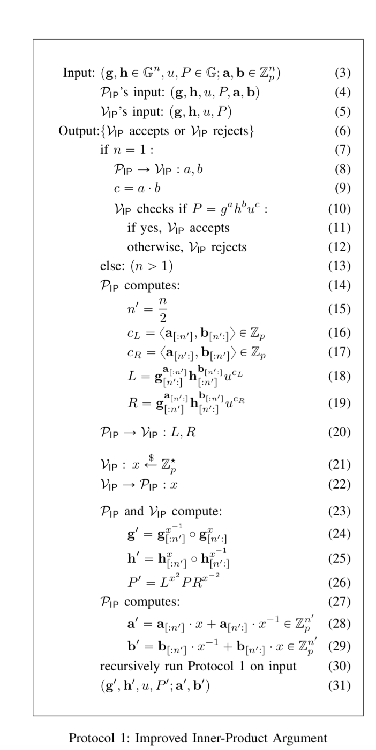
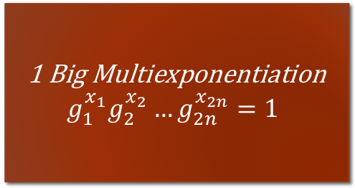
Improving Verification
1 Big Multiexponentiation
$$g_{1}^{x_{1}}g_{2}^{x_{2}}…g_{2n}^{x_{2n}}=1$$

Slide 35
Multiexponentiation is sublinear N/log(N)

Slide 36
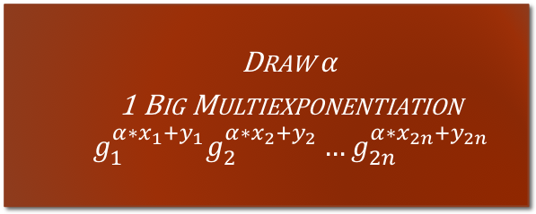
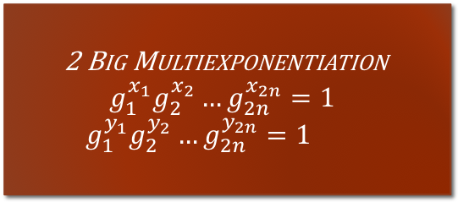

Batch Verificiation (Bellare, Garray, Rabin)
2 Big Multiexponentiation
$$g_{1}^{x_{1}}g_{2}^{x_{2}}…g_{2n}^{x_{2n}}=1$$
$$g_{1}^{y_{1}}g_{2}^{y_{2}}…g_{2n}^{y_{2n}}=1$$
Draw $α$
1 Big Multiexponentiation
$$g_{1}^{α∗x_{1}+y_{1}}g_{2}^{α∗x_{2}+y_{2}}…g_{2n}^{α∗x_{2n}+y_{2n}}=0$$
6.4 ms first verification + 570 $μ$s for each additional proof

Slide 37
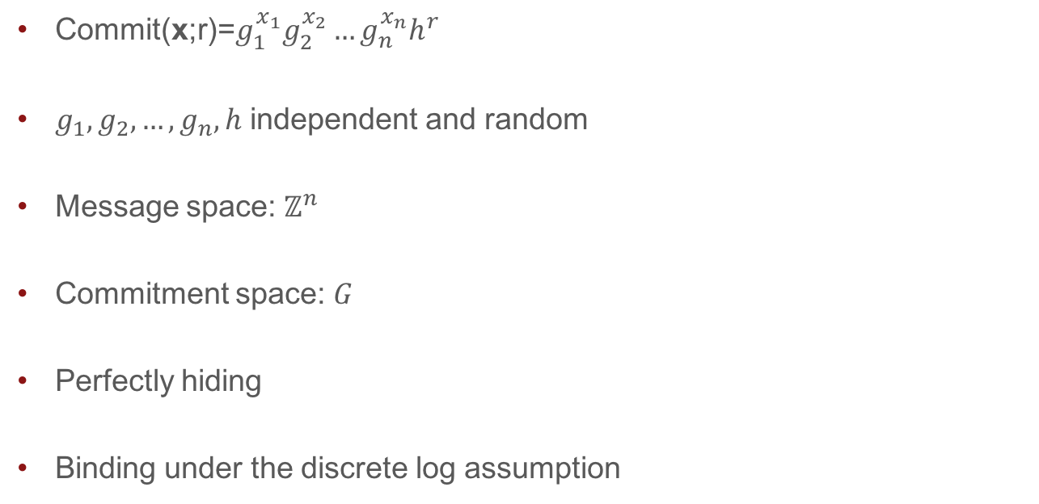
Bulletproof tools: Vector commitments
Commit(x;r)=$g_{1}^{x_{1}}g_{2}^{x_{2}}…g_{n}^{x_{n}}h^{r}$
$g_{1},g_{2},…,g_{n},h$ independent and random
Message space: $ℤ^{n}$
Commitment space: $G$
Perfectly hiding
Binding under the discrete log assumption

Slide 38
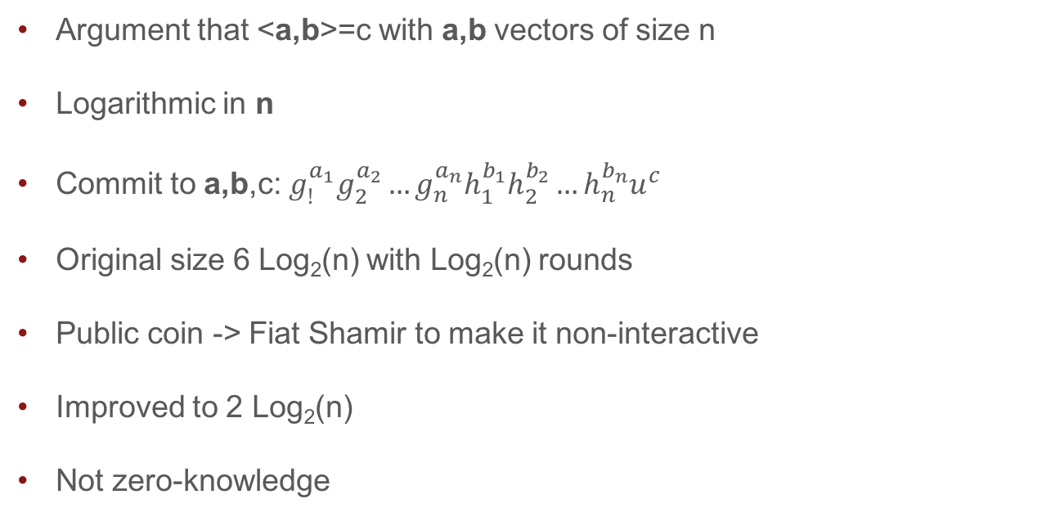
Bulletproof tools: Inner product argument
Argument that <a,b>=c with a,b vectors of size n
Logarithmic in n
Commit to a,b,c: $g_{!}^{a_{1}}g_{2}^{a_{2}}…g_{n}^{a_{n}}h_{1}^{b_{1}}h_{2}^{b_{2}}…h_{n}^{b_{n}}u^{c}$
Original size 6 Log₂(n) with Log₂(n) rounds
Public coin -> Fiat Shamir to make it non-interactive
Improved to 2 Log₂(n)
Not zero-knowledge

Slide 39

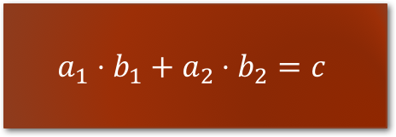
Bulletproofs: Inner Product argument
$$a_{1}⋅b_{1}+a_{2}⋅b_{2}=c$$
$$a^{′}∗b^{′}=c^{′}$$

Slide 40
Bulletproofs : Inner Product argument
New witness
New generator

Slide 41
Bulletproofs: Inner Product argument

Slide 42
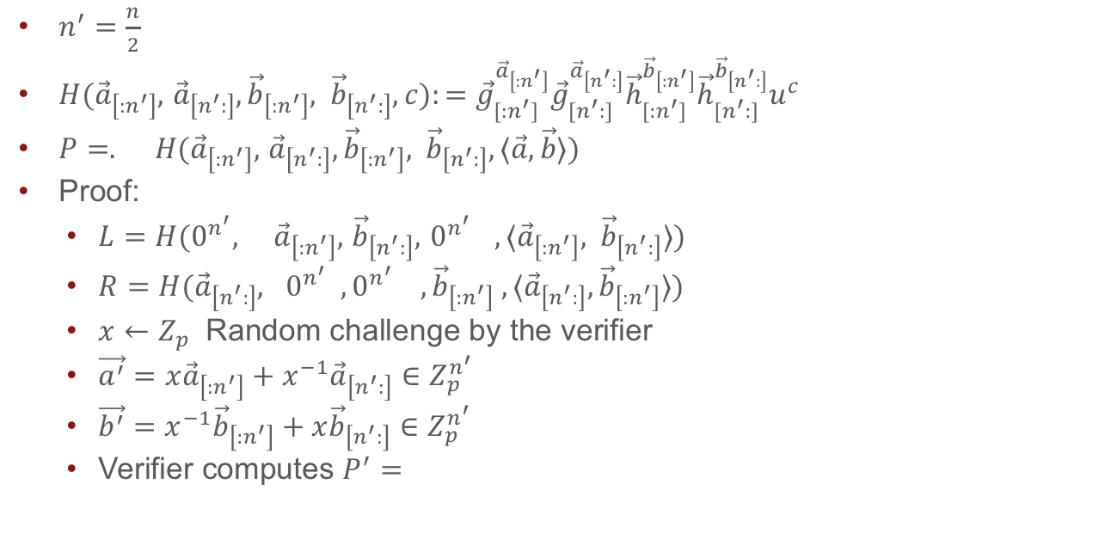
Inner product argument
$n^{′}=\frac{n}{2}$
$H({\vec{a}}_{\left[:n^{′}\right]},$ ${\vec{a}}_{\left[n^{′}:\right]},{\vec{b}}_{\left[:n^{′}\right]}, {\vec{b}}_{\left[n^{′}:\right]},c):={\vec{g}}_{[:n^{′}]}^{{\vec{a}}_{\left[:n^{′}\right]}}{\vec{g}}_{[n^{′}:]}^{{\vec{a}}_{\left[n^{′}:\right]}}{\vec{h}}_{[:n^{′}]}^{{\vec{b}}_{\left[:n^{′}\right]}}{\vec{h}}_{[n^{′}:]}^{{\vec{b}}_{\left[n^{′}:\right]}}u^{c}$
$P=. H({\vec{a}}_{\left[:n^{′}\right]},$ ${\vec{a}}_{\left[n^{′}:\right]},{\vec{b}}_{\left[:n^{′}\right]}, {\vec{b}}_{\left[n^{′}:\right]},⟨\vec{a},\vec{b}⟩)$
Proof:
$L=H(0^{n^{′}}, {\vec{a}}_{\left[:n^{′}\right]},$ ${\vec{b}}_{\left[n^{′}:\right]},{ 0}^{n^{′}} ,⟨{\vec{a}}_{\left[:n^{′}\right]}, {\vec{b}}_{\left[n^{′}:\right]}⟩)$
$R=H({\vec{a}}_{\left[n^{′}:\right]}, 0^{n^{′}} ,0^{n^{′}} , {\vec{b}}_{\left[:n^{′}\right]} ,⟨{\vec{a}}_{\left[n^{′}:\right]},{\vec{b}}_{\left[:n^{′}\right]}⟩)$
$x←Z_{p}$ Random challenge by the verifier
$\vec{a^{′}}=x{\vec{a}}_{\left[:n^{′}\right]}+x^{−1}{\vec{a}}_{\left[n^{′}:\right]}∈Z_{p}^{n^{′}}$
$\vec{b^{′}}=x^{−1}{\vec{b}}_{\left[:n^{′}\right]}+x{\vec{b}}_{\left[n^{′}:\right]}∈Z_{p}^{n^{′}}$
Verifier computes $P^{′}=$

Slide 43
Thank you!
https://crypto.stanford.edu/~buenz
https://crypto.stanford.edu/bulletproofs

Slide 44
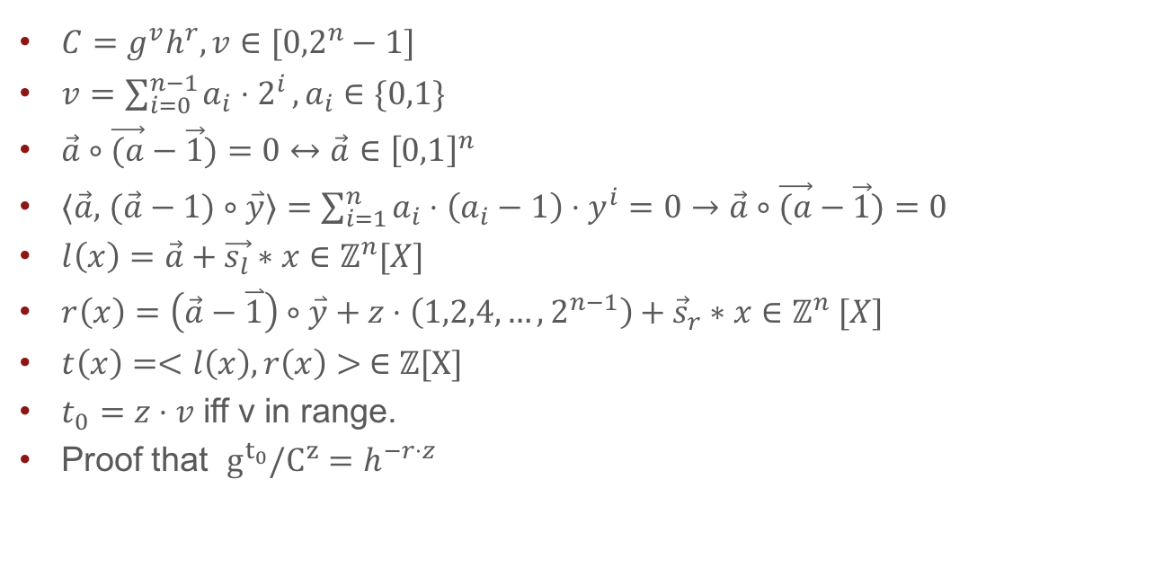
Using the inner product argument
$C=g^{v}h^{r}, v∈[{0,2}^{n}−1]$
$v=\sum_{i=0}^{n−1}{a_{i}⋅2^{i}},a_{i}∈\{0,1\}$
$\vec{a}∘\vec{(a}−\vec{1})=0↔$ $\vec{a}∈{\left[0,1\right]}^{n}$
$⟨\vec{a},$ $(\vec{a}−1)∘\overset{⃑}{y}⟩=\sum_{i=1}^{n}{a_{i}⋅\left(a_{i}−1\right)}⋅y^{i}=0→\vec{a}∘\vec{(a}−\vec{1})=0$
$l\left(x\right)=\vec{a}+\vec{s_{l}}∗x∈ℤ^{n}[X]$
$r\left(x\right)=\left(\vec{a}−\overset{⃑}{1}\right)∘\overset{⃑}{y}+z⋅\left(1,2,4,…, 2^{n−1}\right)+{\vec{s}}_{r}∗x∈ℤ^{n} [X]$
$t\left(x\right)=<l\left(x\right),r\left(x\right)> ∈$ $ℤ[X]$
$t_{0}=z⋅v$ iff v in range.
Proof that $g^{t_{0}}/C^{z}=h^{−r⋅z}$

